Slide 1

UNIVERSITY OF THE ARMED FORCE-ESPE
Responsive Web Design
Name: DENNIS AYO

Slide 2
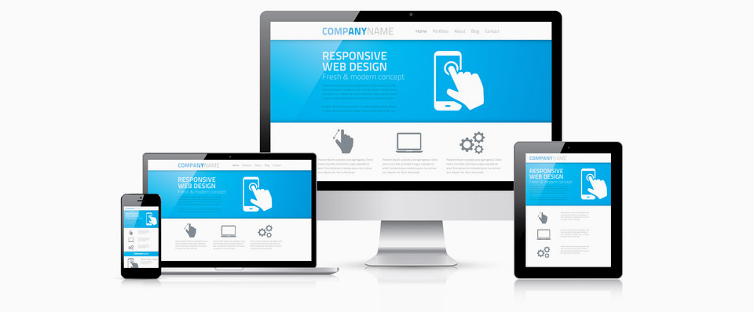
What is responsive design?
Responsive or adaptive web design is a web design technique that seeks the correct display of the same page on different devices. From desktop computers to tablets and mobiles.

Slide 3
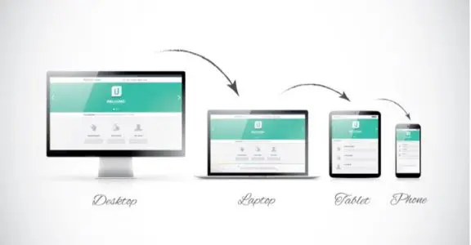
What does responsive design consist of?
We understand responsive websites to be those that are designed and developed for browsing from any device and screen resolution. That is, from any phone we can access an optimized version of said website, without having to download or install any application.

Slide 4
How to make a responsive web design?
It is possible to create your own responsive website using CSS and HTML. But this would be like taking long roads when a freeway is available. In this case, the highway would be a Content Management System (CMS) or a website builder.
A CMS is software that allows you to build your website without having to know how to code, and that includes knowing how to modify a design to make it responsive. Website builders are similar tools, but they give up some functionality that a CMS offers in exchange for ease of use and lower prices.

